Slide 1


Cyber Defense Organization
Fall 2018 - Routers & Security
Spooky edition
DNS is down
Why is my password not working?
Where are my backups??
Hard drives going *tick tick*

Slide 2
Quick Update!

Slide 3

Exploitation Training!
"Exploitation and reverse engineering are arts. They are puzzles. The ultimate video game. Thrilling. Agonizing. They are arts. Come revel in the art with us."​
https://www.exploitation.training/

Slide 4
Word of the Week!
Subnetting

Slide 5
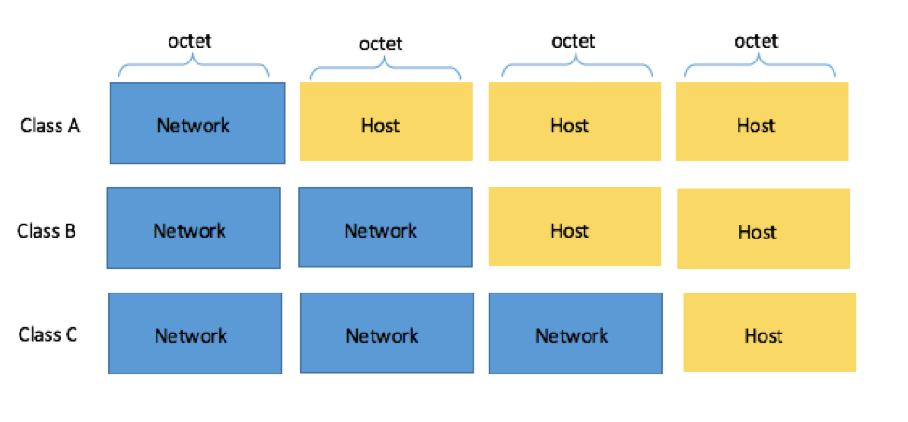
Subnetting
Process of dividing networks into multiple parts
Utilize binary versions of IP address and subnet masks
Basic process:

Slide 6
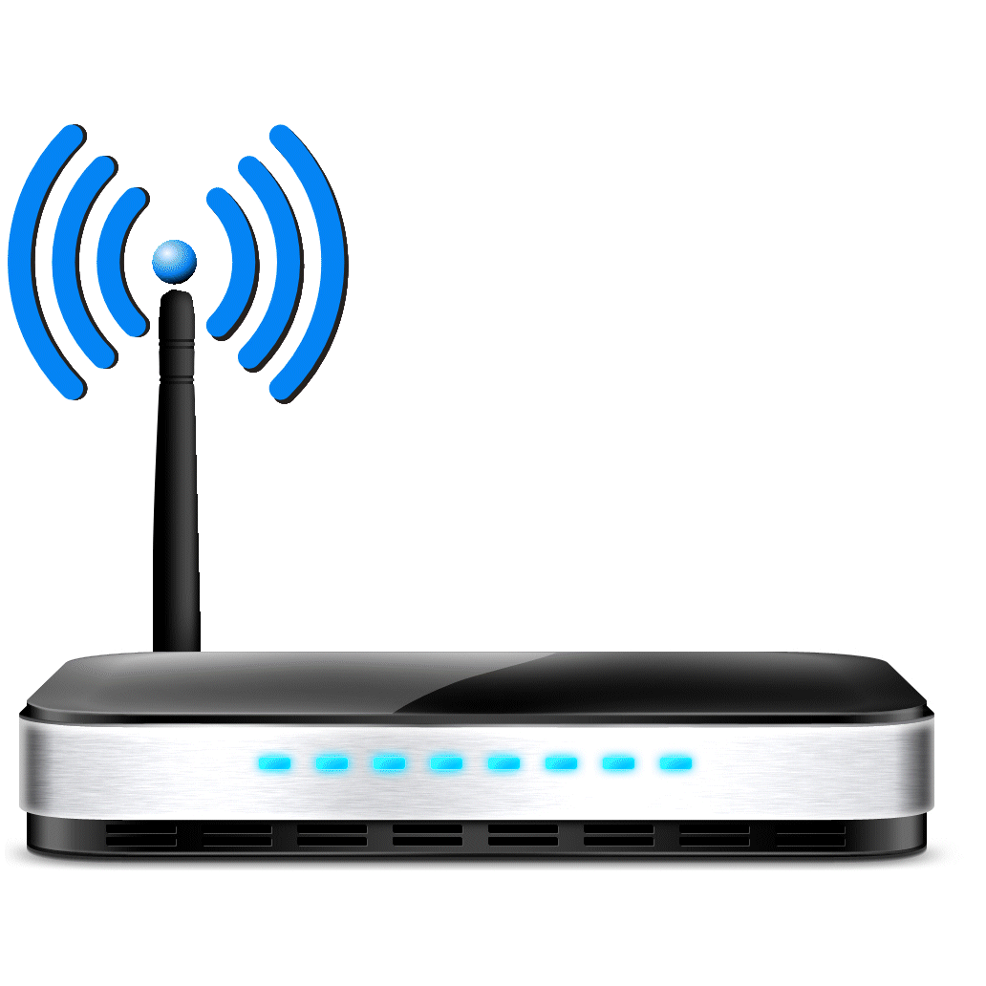
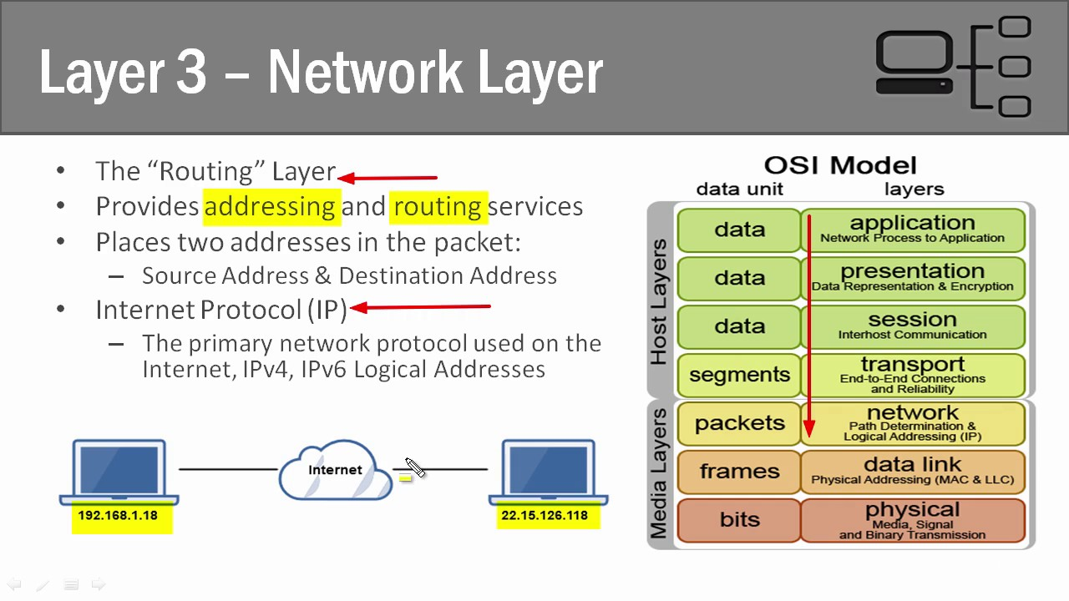
What are Routers?
Layer 3 - Network
Edge of your network
Provide the ever important internet connection to the LAN

Slide 7

The Function of a Router
Allow access to the WAN for LAN devices
How?
Layer 3
IP Address
Subnet mask

Slide 8
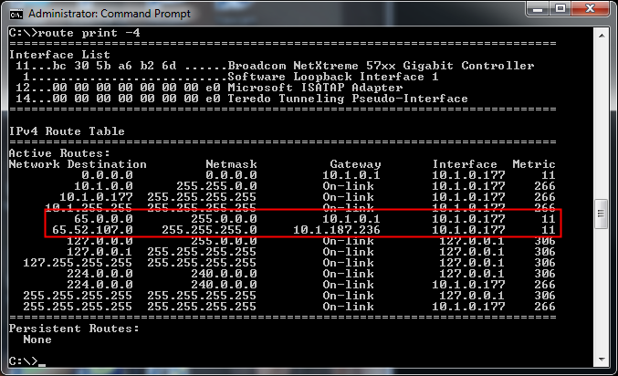
Routing Tables
Logic tables that contain all the known routes in a router
Filled via two methods:
Static routing
Dynamic routing

Slide 9

Static vs. Dynamic
Static:
Manually tell the router where other networks are
Complex with large networks, Easy with small
Dynamic:
Routers automatically fill the table based on what it knows
RIP, BGP, OSPF
Complex for small, Easy for large

Slide 10
To Packet Tracer my Friends!

Slide 11

Security on a Router
Edge of your network
Utilize layers
Configure securely
Minimum resources required
Passwords
Encryption

Slide 12
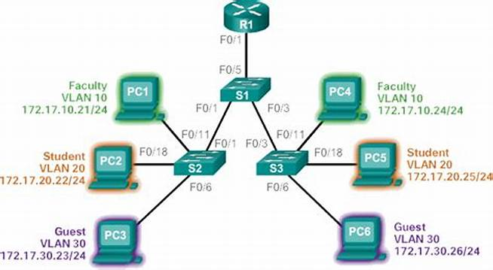
VLANS Application
Further scope down the security of your network
Allows separation in the business in case different departments are present
Myriad of other uses

Slide 13
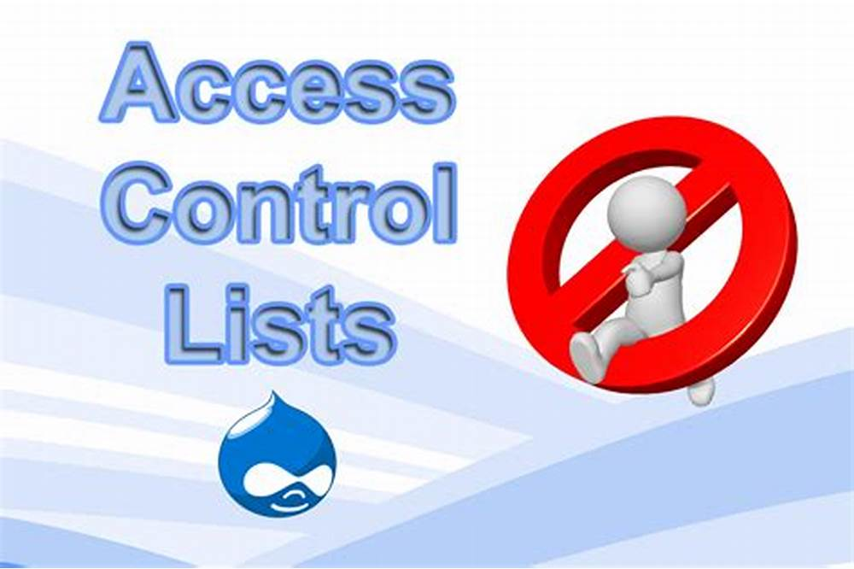
Access Control lists Application
Leverage the created VLANS to implement a business/security policy
Block traffic from certain networks
Principal's about how to implement them

Slide 14
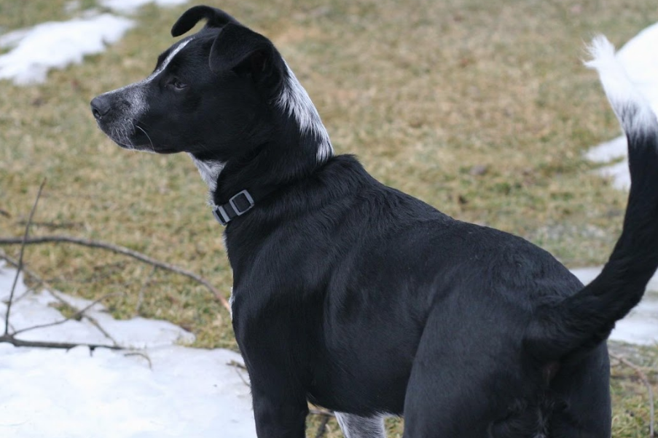

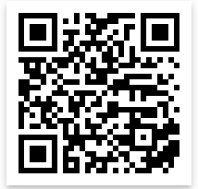
Cya Next week!
Send your cute pet picture to Liam!
wcsmith@albany.edu
Follow us on Twitter? Add on myInvolvement?
CCDC Team! - Monday 7:15pm BB121
Workshop? Yeah probably - Friday 3pm BB123

